Slide 1
Dungeon LF-Party System
Yung Cheng, Adrian U.
STDISCM S14

Slide 2
Deadlock Risks
Since the party members (tanks, healers, and dps) are considered shared resources between the dungeon instances, deadlock could occur if more than 1 instance attempts to form a party alongside another, resulting in one possibly lacking resources.
Deadlock may also occur if multiple dungeons attempt to (1) obtain the same party from the queue, or (2) display status at the same time

Slide 3
Starvation Risk
Dungeon instances may wait indefinitely if the party queue is already empty or a resource is being used by another instance
Dungeon instances may face delays in displaying their statuses if there is a high contention between multiple instances
Dungeon instances with a shorter runtime may continue to grab parties, leaving other instances with less parties to run

Slide 4
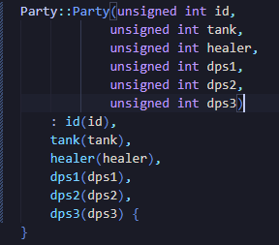
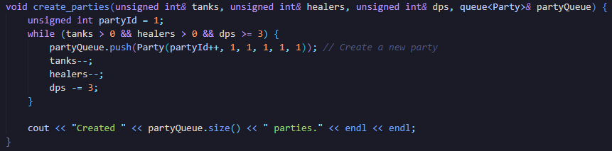
Synchronization Mechanic – Pre-formed Parties
Parties are formed and stored into a Queue before any dungeon instance is executed. This ensures that the chances of any deadlocks regarding forming parties to occur is reduced.
Party representation
Parties are formed as soon as values for the party roles are provided by the user

Slide 5
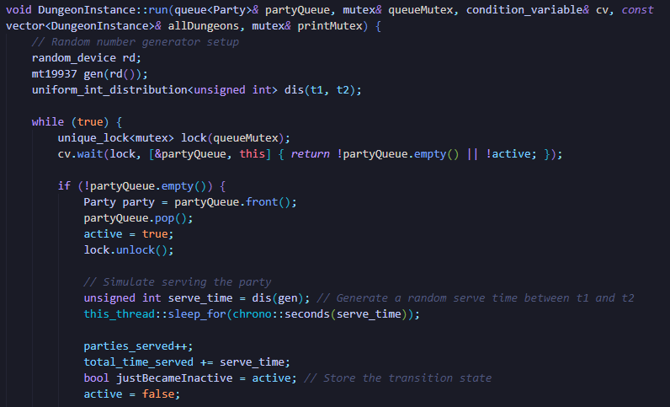
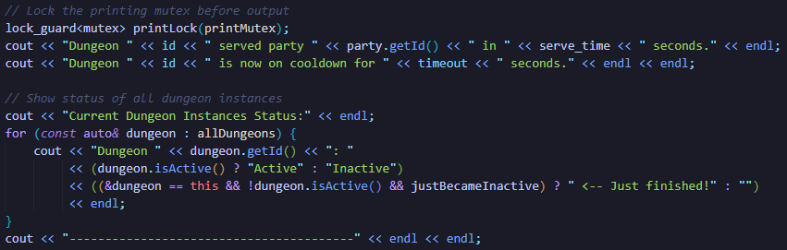
Synchronization Mechanism – Mutex Locks
Mutex locks are placed on the party queue and the print access to ensure that only a single dungeon instance may obtain a formed party and/or display its status at a time.
Print mutex for status displays
NOTE:
Queue mutex immediately unlocks as soon as the dungeon instance obtains a party.
Print mutex is placed only where printing is necessary to prevent locking other resources
Queue mutex for obtaining a formed party

Slide 6
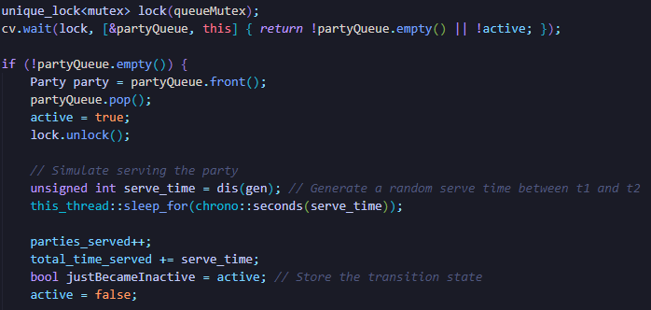

Synchronization Mechanism – Condition Variable
A condition variable is placed onto the dungeon instance to check first if (1) the party queue is not empty OR (2) the current instance becomes inactive to function or run
This ensures that the dungeon instances only have to be notified if one of the conditions to become true instead of indefinitely waiting and checking
Dungeon stops waiting if party queue is empty
Dungeon instance simulation if cv conditions are passed

Slide 7
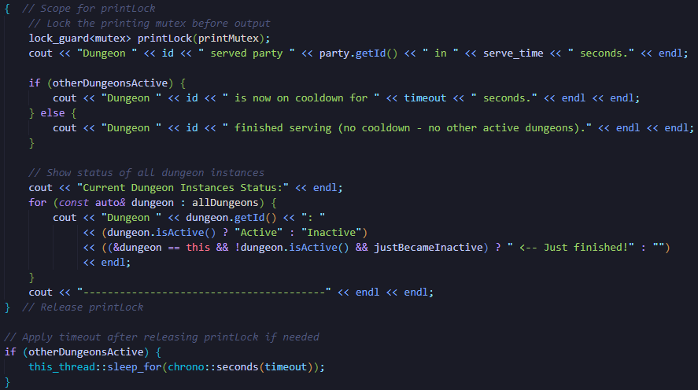
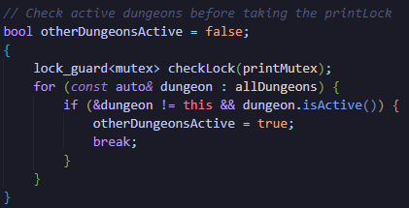
Fairness Mechanism – Timeout
A timeout (default 2 seconds) is placed on a dungeon instance after it completes its current execution to ensure a certain level of fairness for obtaining parties across all instances.
A dungeon only receives a timeout if there are other active dungeons. If there are none, that signifies the completion of all parties.
Check if other dungeons are active
Forces the dungeon instance to sleep to prevent resource starvation

